Slide 1
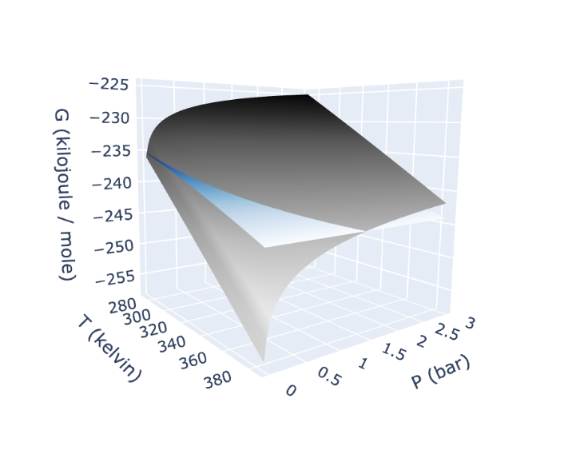
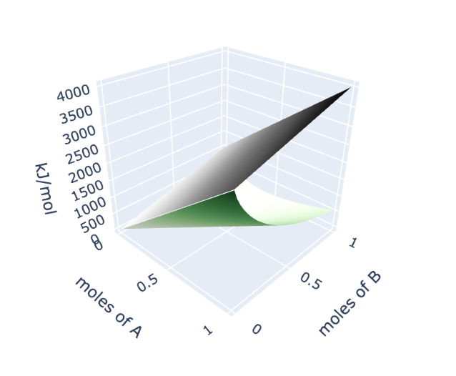
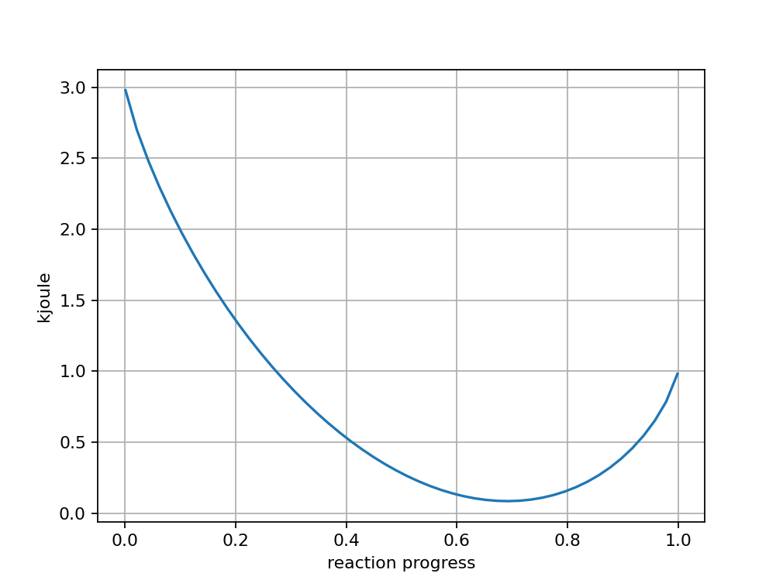

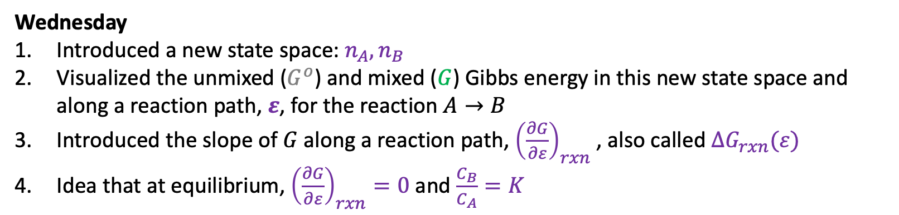

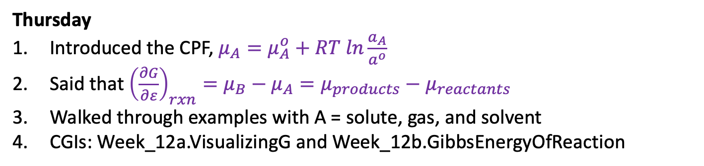
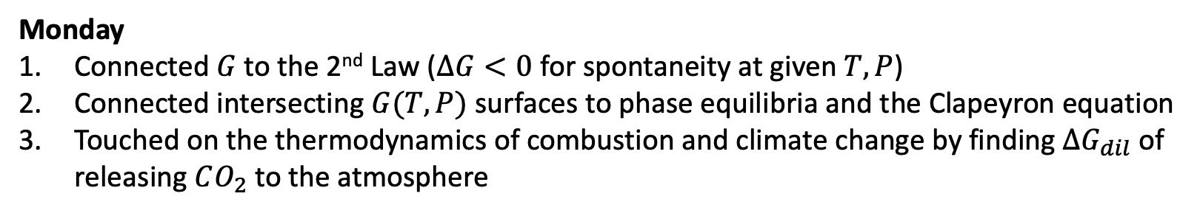
Recap of the week
Monday
Connected $G$to the 2nd Law ($∆G<0$ for spontaneity at given $T,P$)
Connected intersecting $G(T,P)$ surfaces to phase equilibria and the Clapeyron equation
Touched on the thermodynamics of combustion and climate change by finding $∆G_{dil}$ of releasing $CO_{2}$ to the atmosphere
Gas
Liquid
Wednesday
Introduced a new state space: $n_{A},n_{B}$
Visualized the unmixed ($G^{o}$) and mixed ($G$) Gibbs energy in this new state space and along a reaction path, $ε$, for the reaction $A→B$
Introduced the slope of $G$ along a reaction path, ${\left(\frac{∂G}{∂ε}\right)}_{rxn}$ , also called $∆G_{rxn}(ε)$
Idea that at equilibrium, ${\left(\frac{∂G}{∂ε}\right)}_{rxn}=0$ and $\frac{C_{B}}{C_{A}}=K$
$$G^{o}$$
$$G$$
Thursday
Introduced the CPF, $μ_{A}=μ_{A}^{o}+RT ln\frac{a_{A}}{a^{o}}$
Said that ${\left(\frac{∂G}{∂ε}\right)}_{rxn}=μ_{B}−μ_{A}=μ_{products}−μ_{reactants}$
Walked through examples with A = solute, gas, and solvent
CGIs: Week_12a.VisualizingG and Week_12b.GibbsEnergyOfReaction

Slide 2
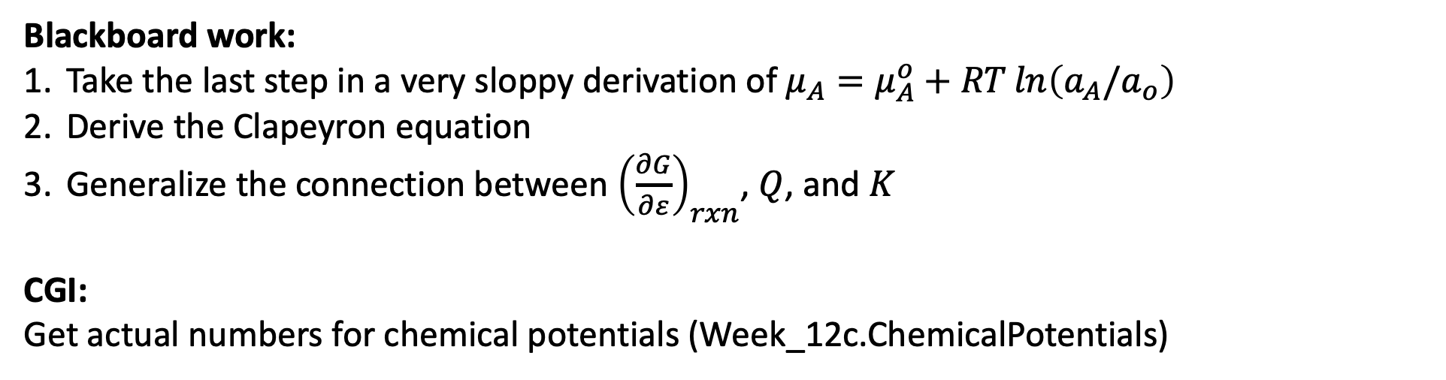
Today
Blackboard work:
Take the last step in a very sloppy derivation of $μ_{A}=μ_{A}^{o}+RT\ln\left(a_{A}/a_{o}\right)$
Derive the Clapeyron equation
Generalize the connection between ${\left(\frac{∂G}{∂ε}\right)}_{rxn}$, $Q$, and $K$
CGI:
Get actual numbers for chemical potentials (Week_12c.ChemicalPotentials)

Slide 3





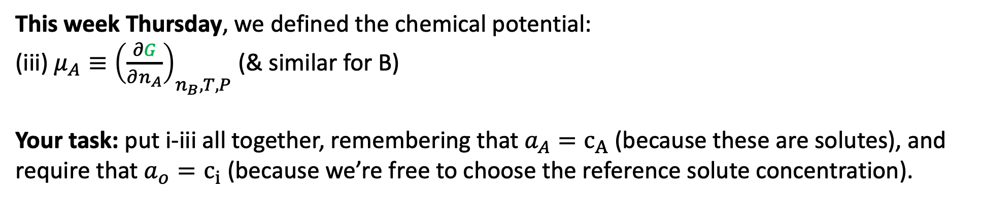

1. A very sloppy derivation of $μ_{A}=μ_{A}^{o}+RT\ln\left(a_{A}/a_{o}\right)$
Last week Wednesday, we argued this about the entropy of mixing:
$$n_{A}$$
$$c_{B,f}$$
$$n_{B}$$
$$c_{A,f}$$
$$c_{init}$$
$$c_{init}$$
(i) $∆S_{mix}=−n_{A}Rln\left(\frac{C_{A,f}}{C_{init}}\right)−n_{B}Rln\left(\frac{C_{B,f}}{C_{init}}\right)$ (“double dilution idea”)
This week Monday, we said this about the Gibbs energy of a reaction mixture:
(ii) $G=G^{o}+$ ${∆G}_{mix}= {n_{A}∆G}_{f}^{o}\left(A\right)+{n_{B}∆G}_{f}^{o}\left(B\right)−$ $T∆S_{mix}$
This week Thursday, we defined the chemical potential:
(iii) $μ_{A}≡{\left(\frac{∂G}{∂n_{A}}\right)}_{n_{B}, T,P}$ (& similar for B)
Your task: put i-iii all together, remembering that $a_{A}=c_{A}$ (because these are solutes), and require that $a_{o}=c_{i}$ (because we’re free to choose the reference solute concentration).

Slide 4
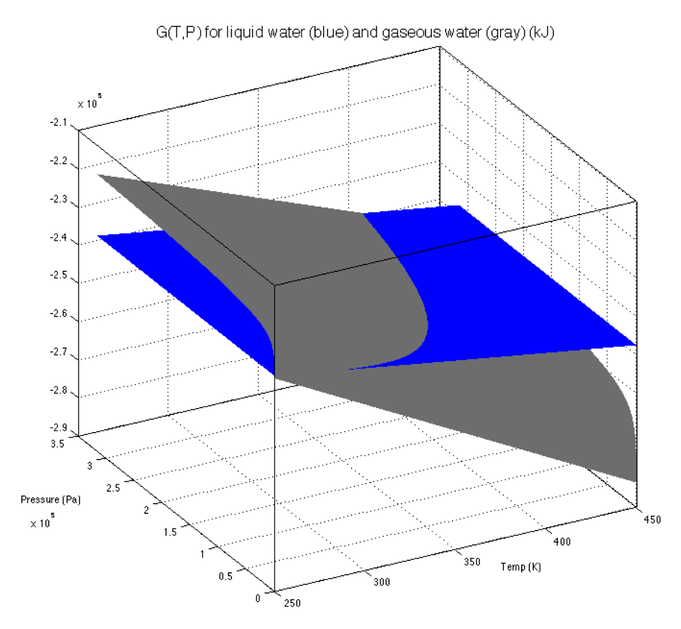
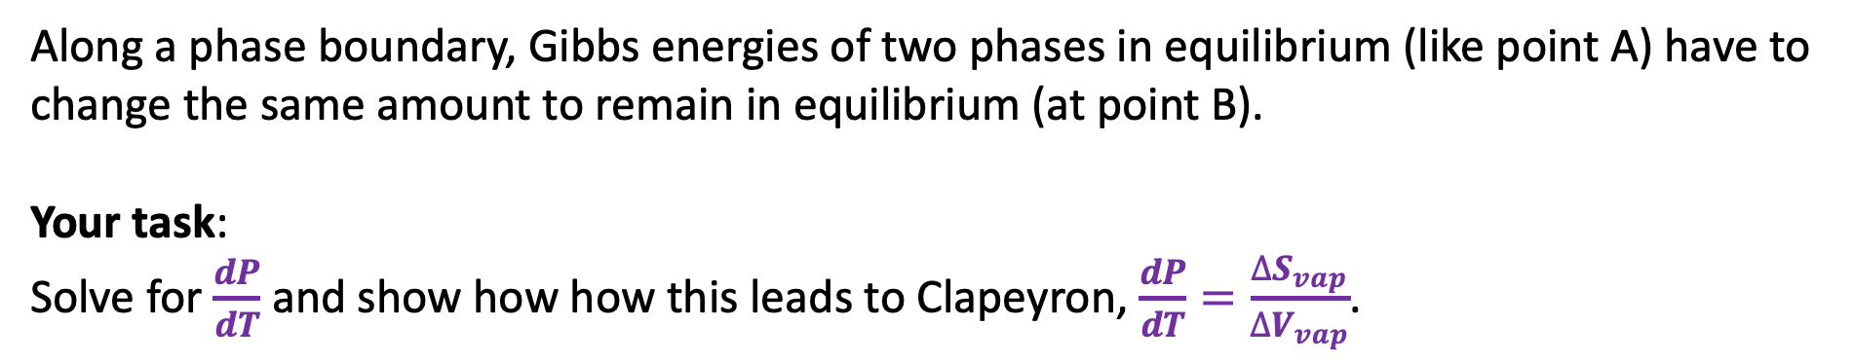
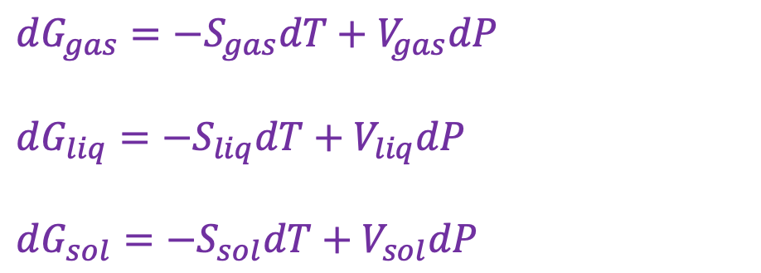
2. Deriving the Clapeyron equation
$dG_{gas}=−S_{gas}dT+V_{gas}dP$
$dG_{liq}=−S_{liq}dT+V_{liq}dP$
$dG_{sol}=−S_{sol}dT+V_{sol}dP$
B
A
Along a phase boundary, Gibbs energies of two phases in equilibrium (like point A) have to change the same amount to remain in equilibrium (at point B).
Your task:
Solve for $\frac{dP}{dT}$ and show how how this leads to Clapeyron, $\frac{dP}{dT}=\frac{∆S_{vap}}{∆V_{vap}}$.

Slide 5
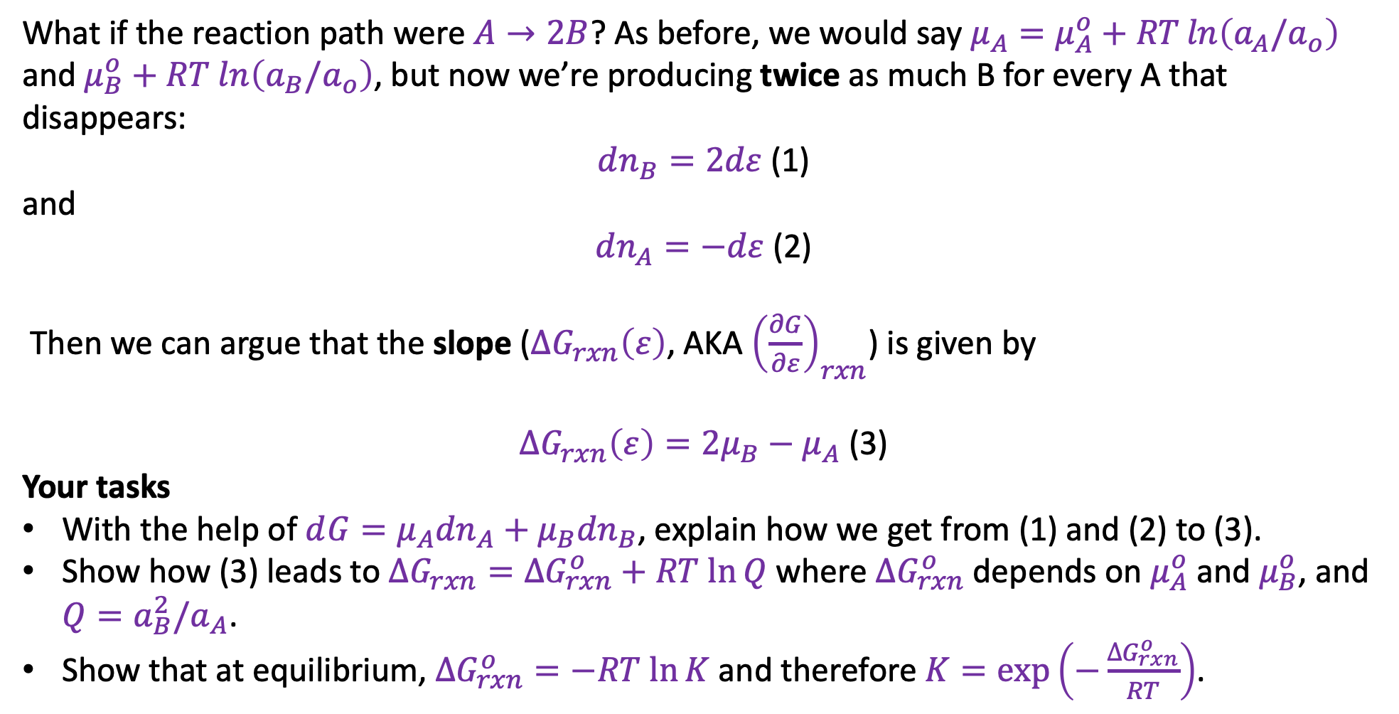
3. Generalizing the connection between ${\left(\frac{∂G}{∂ε}\right)}_{rxn}$, $∆G_{rxn}\left(ε\right)$, $Q$, and $K$
What if the reaction path were $A→2B$? As before, we would say $μ_{A}=μ_{A}^{o}+RT\ln\left(a_{A}/a_{o}\right)$ and $μ_{B}^{o}+RT ln\left(a_{B}/a_{o}\right)$, but now we’re producing twice as much B for every A that disappears:
$dn_{B}=2dε$ (1)
and
$dn_{A}=−dε$ (2)
Then we can argue that the slope ($∆G_{rxn}\left(ε\right)$, AKA ${\left(\frac{∂G}{∂ε}\right)}_{rxn}$) is given by
$∆G_{rxn}\left(ε\right)={2μ}_{B}−μ_{A}$ (3)
Your tasks
With the help of $d{G=μ_{A}dn}_{A}+{μ_{B}dn}_{B}$, explain how we get from (1) and (2) to (3).
Show how (3) leads to $∆G_{rxn}=∆G_{rxn}^{o}+RT ln⁡Q$ where $∆G_{rxn}^{o}$ depends on $μ_{A}^{o}$ and $μ_{B}^{o}$, and $Q={a_{B}^{2}/a}_{A}$.
Show that at equilibrium, $∆G_{rxn}^{o}=−RT ln⁡K$ and therefore $K=\exp\left(−\frac{∆G_{rxn}^{o}}{RT}\right)$.

